Slide 1

Chapter 19: International Trade
Wayne Geerling
University of Texas

Slide 2
Big Questions
Is globalization for real?
How does international trade help the economy?
What are the effects of tariffs and quotas?

Slide 3

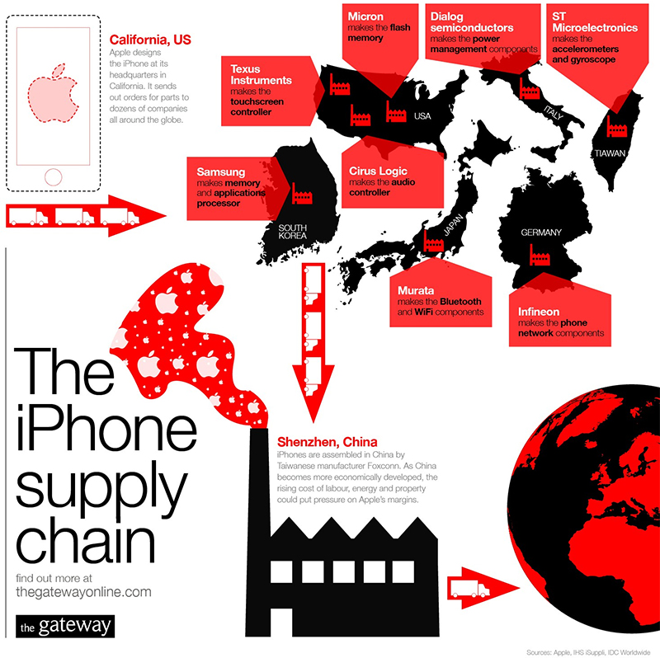
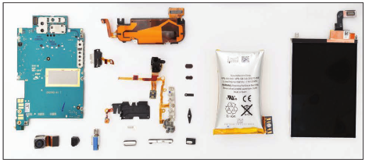
How many borders does an iPhone cross before it is sold?

Slide 4
Globalization
Globalization is the increased interdependence of economies around the globe.
Factors driving globalization are:
Lower shipping & communication costs
Reduced trade barriers
Increased specialization

Slide 5
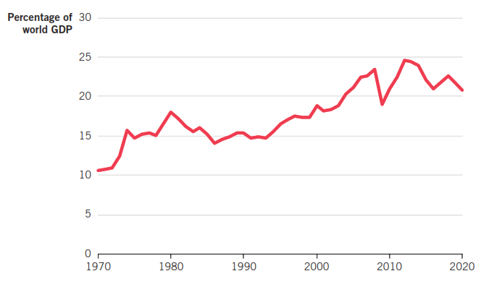
Growth in World Trade

Slide 6
Some Trade Definitions
Net exports: The total exports of final goods & services minus total imports of final goods & services.
Trade balance: The difference between a nation’s total exports & total imports.
Trade surplus: When exports > imports, indicating a positive trade balance.
Trade deficit: When imports > exports, indicating a negative trade balance.

Slide 7
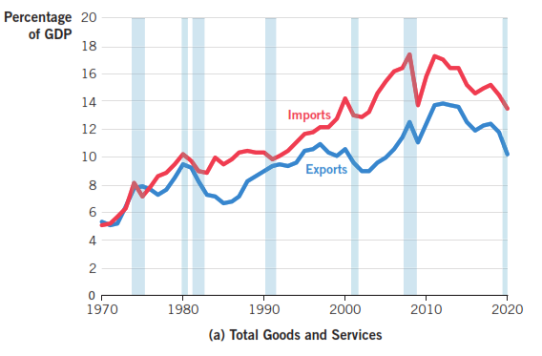
Trends in U.S. Trade: Goods & Services

Slide 8
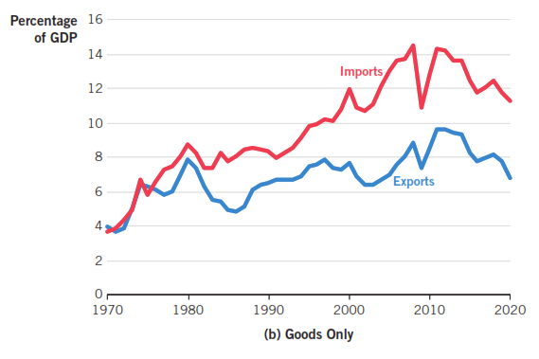
Trends in U.S. Trade: Goods Only

Slide 9
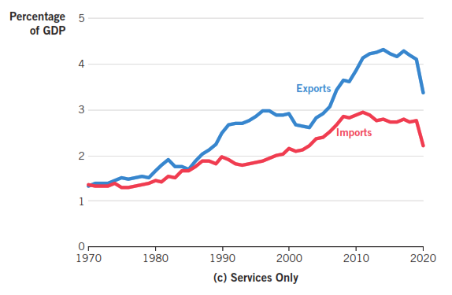
Trends in U.S. Trade: Services Only

Slide 10
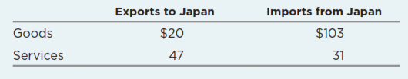
Trade in Goods & Services: Deficit or Surplus
U.S. goods trade balance is: $20 BN - $103 BN = -$83 BN
U.S. services trade balance is: $47 BN - $31 BN = $16 BN
Overall U.S. trade balance is $67 BN - $134 BN = -$67 BN (trade deficit)

Slide 11
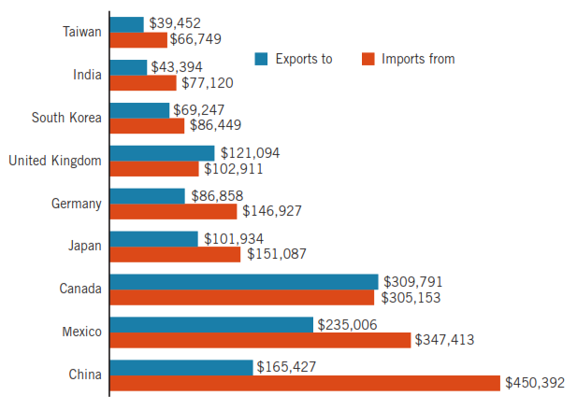
Major Trading Partners of the U.S.

Slide 12
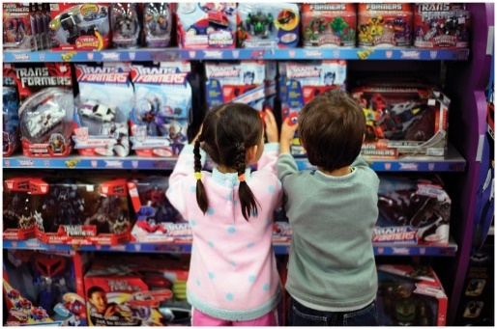
Comparative Advantage
The ability to produce a good at a lower opportunity cost than a competitor can.
Gains arise when a nation specializes in production & exchanges its output with a trading partner.
Trade leads to lower capital costs of production & maximizes the combined output of all nations involved.

Slide 13
Comparative Advantage
To better understand comparative advantage and the gains of trade, let’s assume . . .
United States & Mexico produce food and clothing.
Food is capital intensive, and clothing is labor intensive.
United States has abundant capital, and a skilled workforce.
Mexico has a less-skilled workforce.
Which country will specialize in which good?

Slide 14
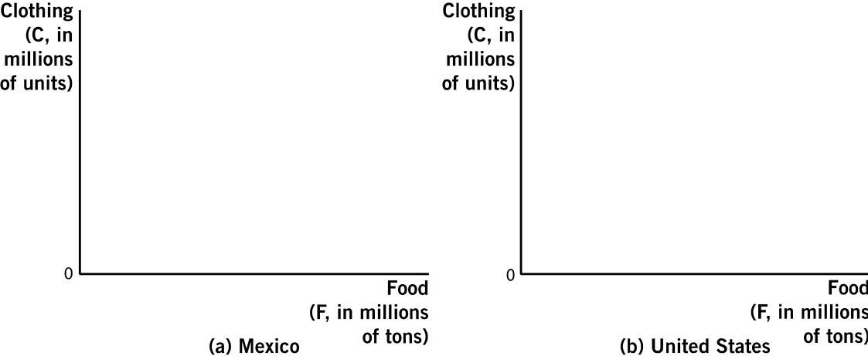
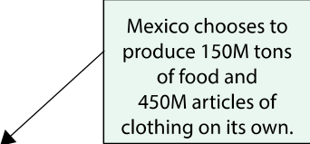
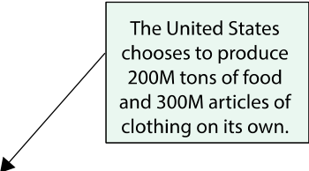
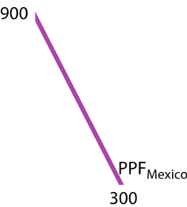
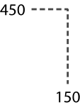
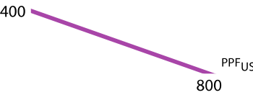
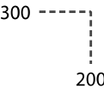
Gains From Trade

Slide 15
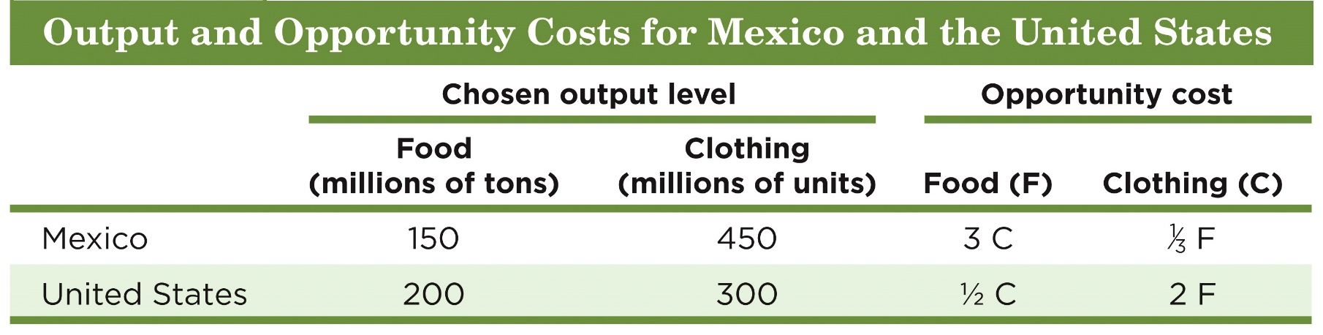
Gains From Trade
Which country will specialize in which good?
Because Mexico has a lower opportunity cost in clothing, it should specialize in clothing.
Because the U.S. has a lower opportunity cost in food, it should specialize in food production.

Slide 16
Gains From Trade
Countries benefit from trade when:
A country can acquire goods for a lower opportunity cost than if they had to produce it.
If they can sell a good for a higher opportunity cost than what it cost to produce it.
In our example:
Mexico will want more than $\frac{1}{3}$ unit of food for 1 unit of clothing.
The United States will want to give less than 2 units of food for 1 unit of clothing.
So: $\frac{1}{3}$ food < price of one unit clothing < 2 food.

Slide 17
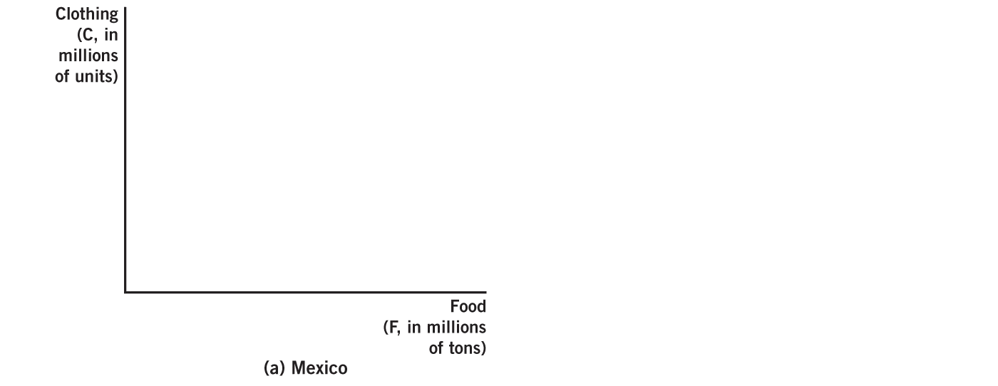
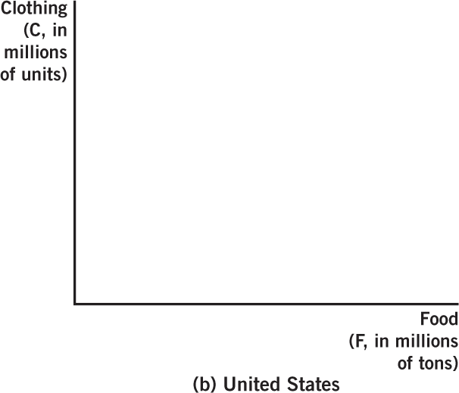
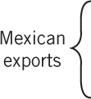
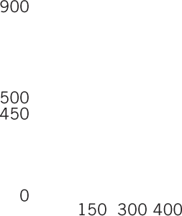





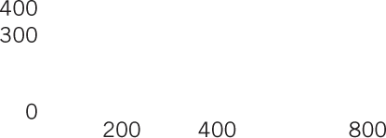






Gains From Trade
Assume: 1 unit of food trades for 1 unit of clothing.
M1 & US1 are pre-trade production points.
Mexico specializes in clothing & U.S. specializes in food.
400M units of clothing traded for 400M units of food.

Slide 18
Class Activity
Output and Opportunity Cost for Canada and the U.S.
 | Chosen Output Level |  | Opportunity Cost
 | Food | Cars | Food | Cars
Canada | 100 | 20 | 1/5 car | 5 food
U.S. | 500 | 50 | 1/10 car | 10 food
Calculate the opportunity costs of food and cars for each country.
Which country should specialize in food? In cars?
Food (U.S): 1/10 < 1/5; Cars (Canada): 5 < 10
If Canada and the U.S. trade, how much food will a car trade for?
Between 5-10 units of food

Slide 19
Class Activity
Output and Opportunity Cost for Canada and the U.S.
 | Chosen Output Level |  | Opportunity Cost
 | Food | Cars | Food | Cars
Canada | 100 | 20
U.S. | 500 | 50
1. Calculate the opportunity costs of food and cars for each country.
2. Which country should specialize in food? In cars?
3. If Canada and the U.S. trade, how much food will a car trade for?

Slide 20
Other Advantages of Trade
Economies of scale:
Smaller countries get access to goods that require large-scale production.
Access to new markets allows countries to take advantage of economies of scale & therefore lower per-unit costs as production expands.
Increased competition:
Forces domestic firms to become more innovative& to compete in terms of both quality & price
Consumers have more choice.

Slide 21
Other Advantages of Trade
Gains from trade often spurs nations to sign trade agreements to reduce tariffs & clear the way for mutually beneficial exchange.
USMCA (Formerly NAFTA):
Trade agreement between the U.S., Mexico & Canada.
World Trade Organization (WTO):
Regulates the trade of various goods & services, including textiles, investment, intellectual property & agriculture.
Also works to resolve trade disputes.

Slide 22
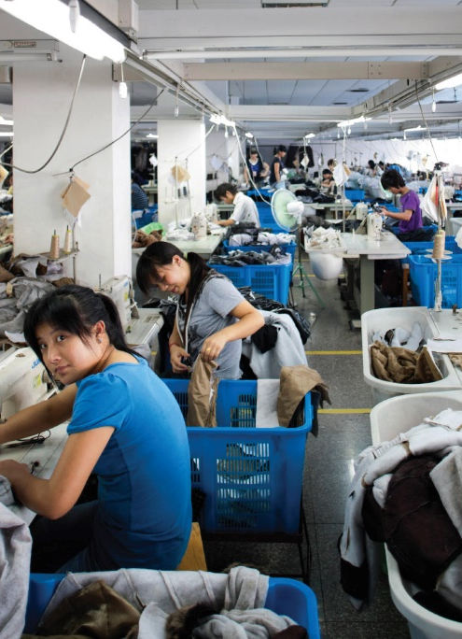
Protectionism
A blanket term for governmental actions & policies that restrict or restrain international trade, often with the intent of protecting local businesses & jobs from foreign competition.
Two of the most common measures are:
1. Tariffs
2. Import quotas

Slide 23
Tariffs & Import Quotas
Tariffs
Taxes levied on imported goods & services.
Types:
Ad valorem tax: A % of the value of the good.
Specific tax: A per-unit tax.
Mix of the two.
Quotas
Limits on the quantity of products that can be imported into a country.
Function like tariffs, except that the government does not receive any revenue.

Slide 24
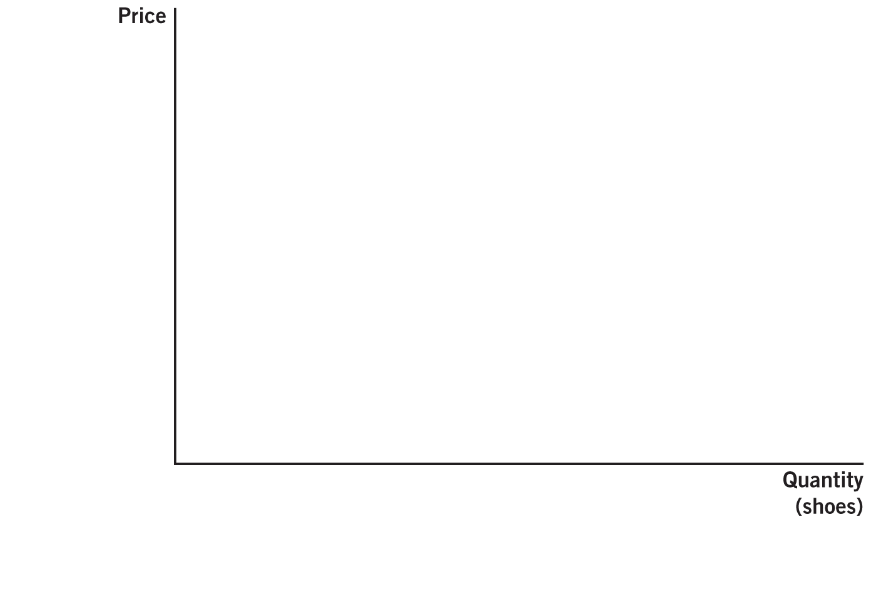
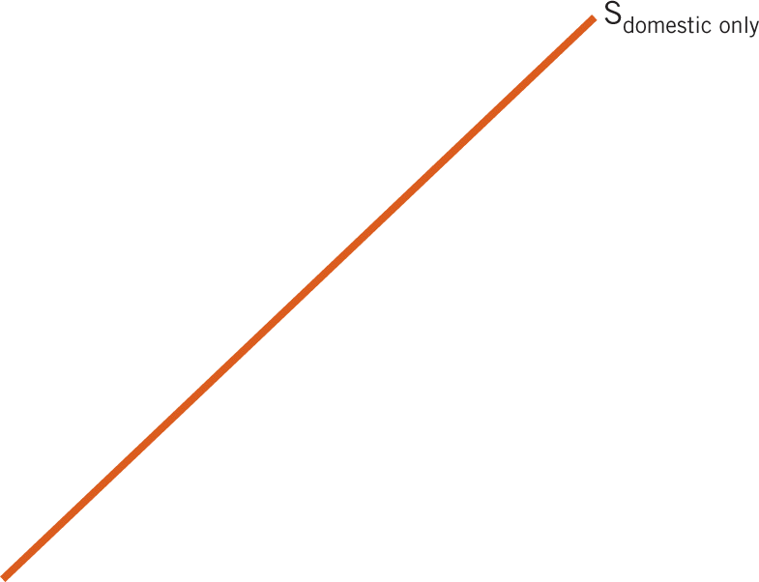
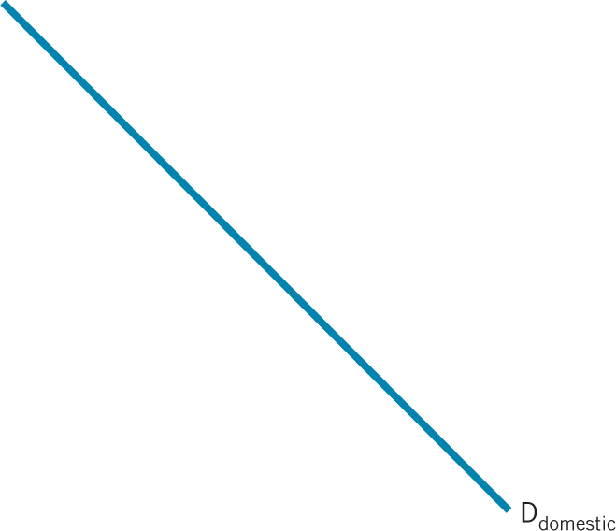
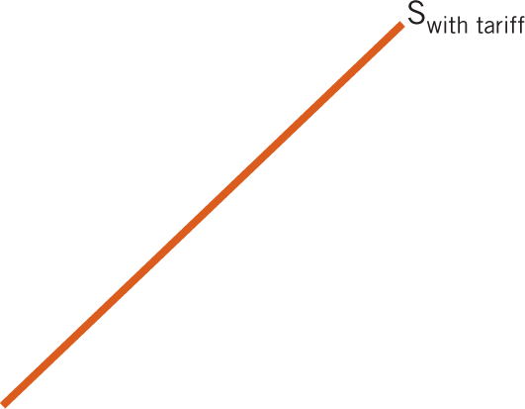
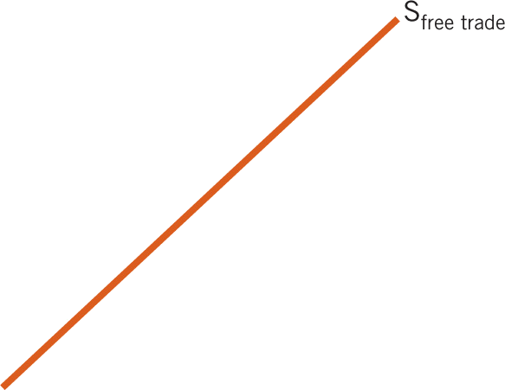
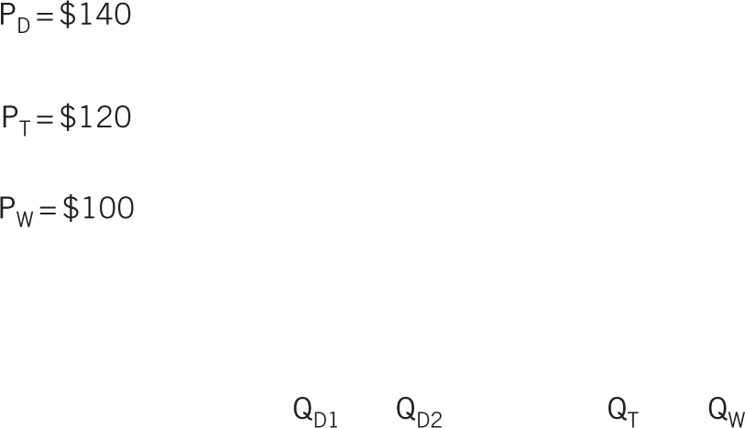






Tariffs, Graphically

Slide 25

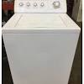
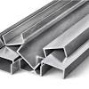



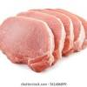

U.S.-China Trade War
Since 1980s, U.S. trade deficit with China has grown from $4 BN to c. $300 BN.
Former president Trump imposed tariffs on Chinese imports in January 2018:
China retaliated by imposing tariffs on

Slide 26
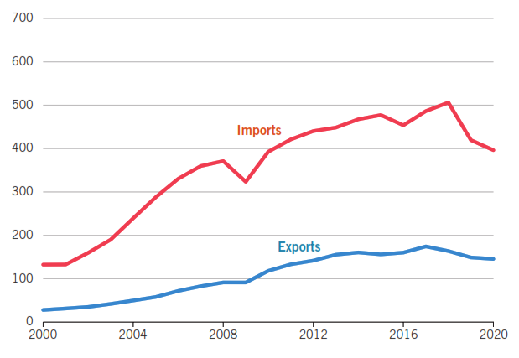
U.S. Goods & Services Trade with China

Slide 27
Effect of Tariffs
Consumer welfare is lost since consumers pay more & the quantity they buy is less.
Domestic producers gain since they can now sell more.
However, they can sell less abroad.
Foreign producers lose since the amount they sell falls.
There is a welfare loss since total sales fall & inefficient producers increase production.
Government generates revenue from tariffs.

Slide 28
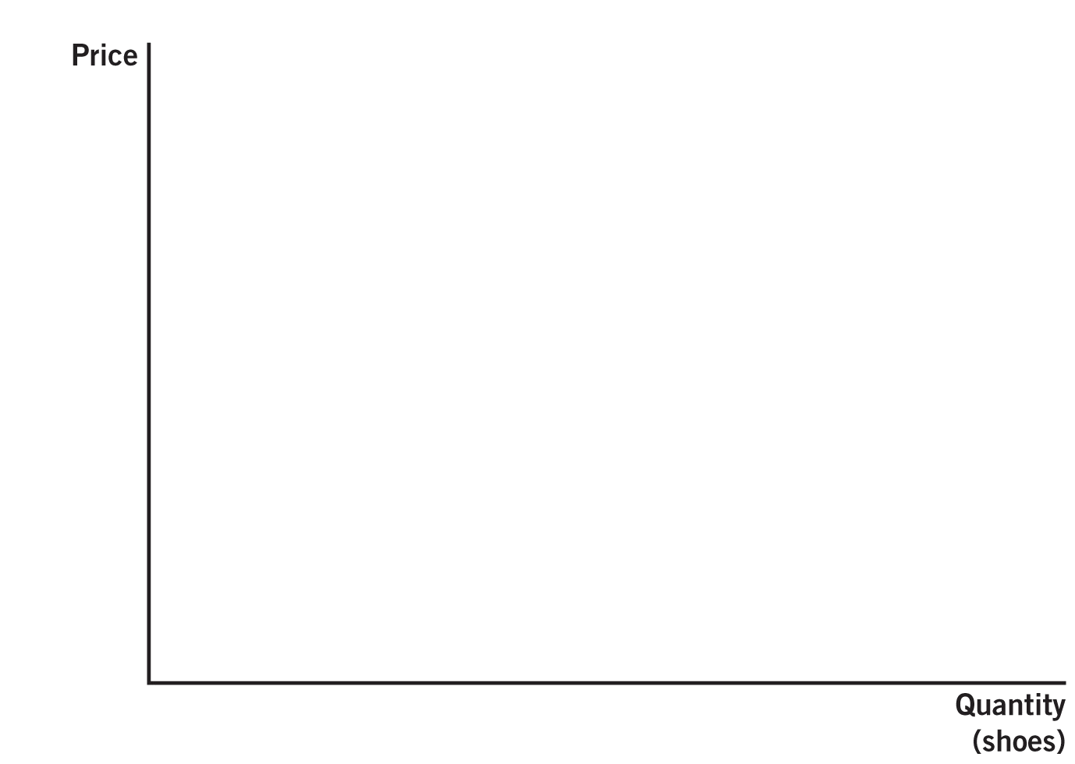
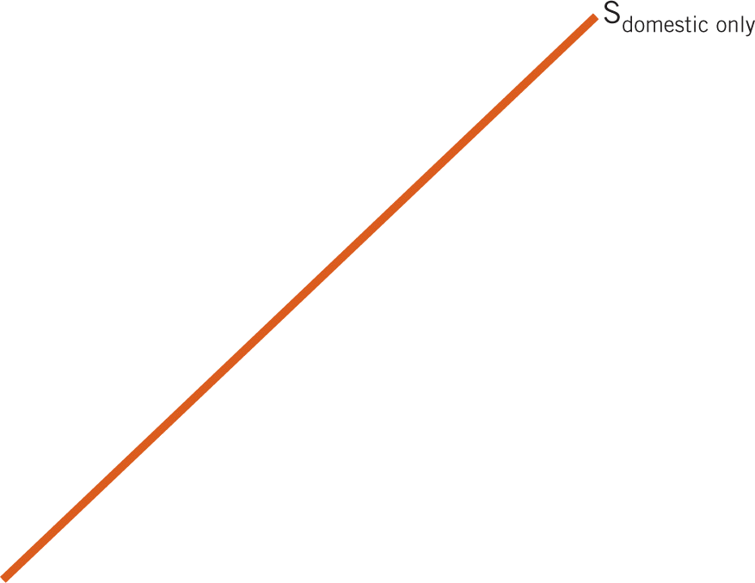
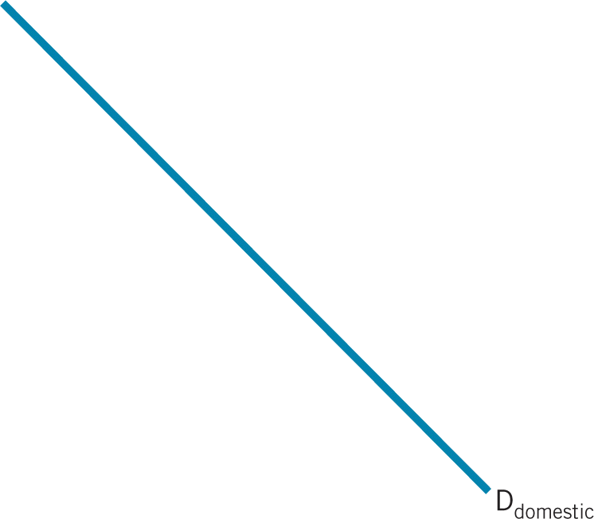
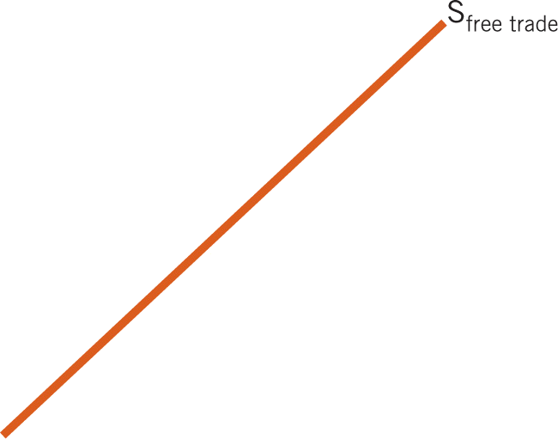
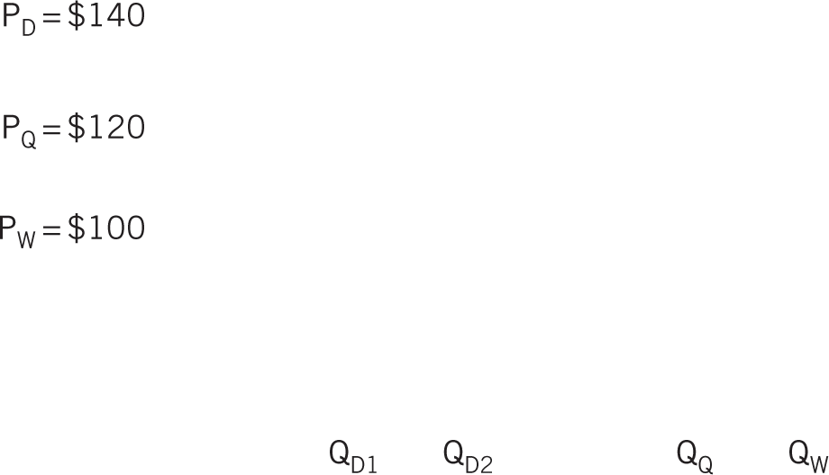






Quotas, Graphically

Slide 29
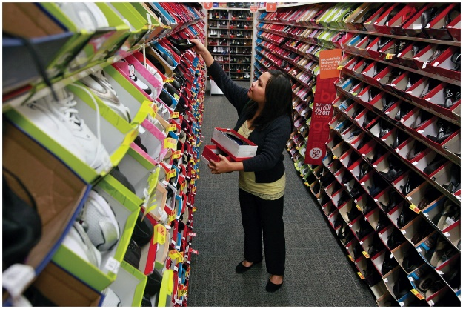
Effect of Quotas
Similar to a tariff, except with a quota there is no government tariff revenue.
Consumer welfare is lost
Domestic producers are better off.
Efficiency loss is the same as for tariffs.
Foreign producers will “voluntarily” agree to restrict their exports.

Slide 30
Reasons Given for Trade Barriers
1. National security:
Better to produce goods vital to national defense on your own.
For example: weapons, energy, transportation.
2. Infant industry argument:
States that domestic industries need trade protection until they are established & able to compete internationally.
However, firms that lobby for protection are often operating in an established industry.

Slide 31
Reasons Given for Trade Barriers
3. Retaliation for dumping:
Dumping: When a foreign supplier sells a good below the price it charges in its home country.
Dumping is deliberately used to penetrate a foreign market.
If dumping is subsidized, countries can impose countervailing duties to offset.
Favors to special interests:
Companies seek favors at the expense of U.S. consumers.

